Slide 1
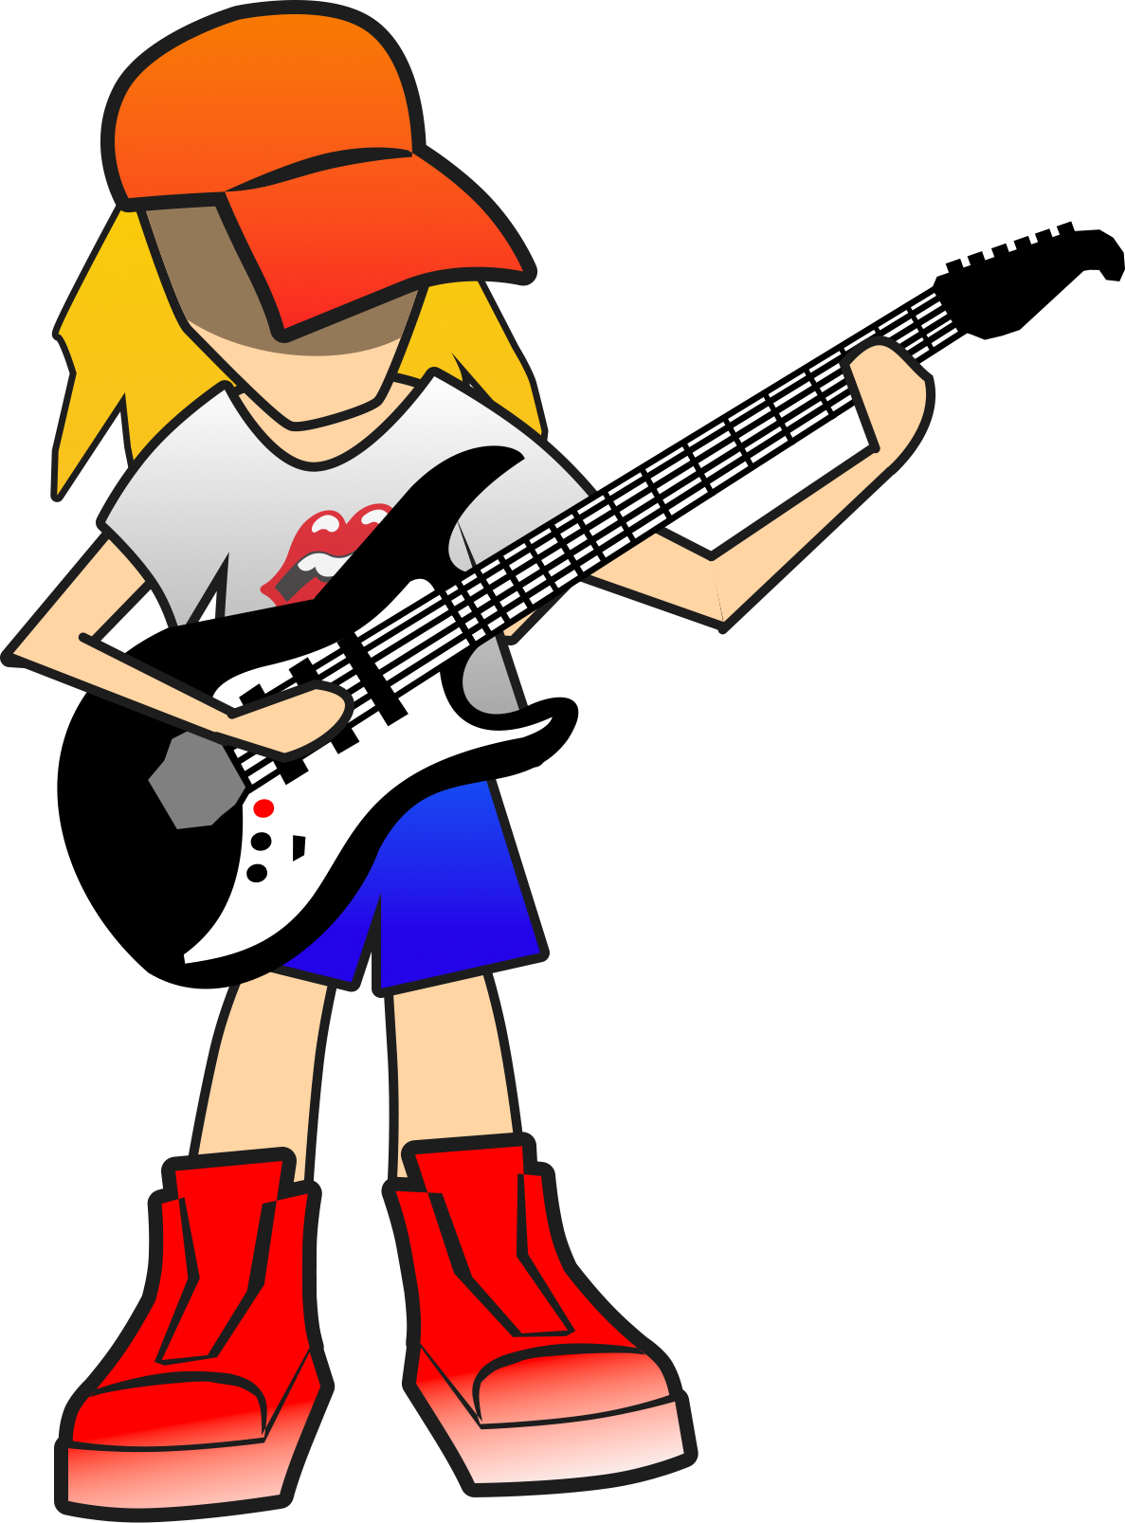
INSTTRUMENT DUEL
A Rhythm Based Clicker Game with Performance Driven Progression

Slide 2
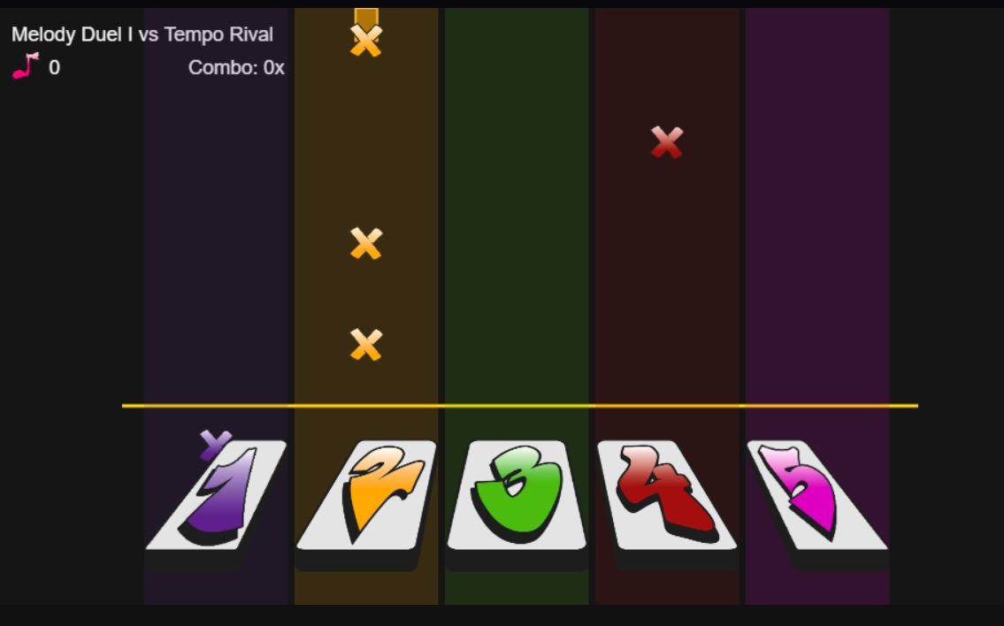
OVERVIEW
Instrument Duel is a browser based rhythm clicker hybrid game
Combat is replaced by musical performance: play note sequences instead of physical attacks
Each level is a musical duel against an opponent
Win by achieving a higher score through better timing, accuracy, and consistency
Even if you lose, you earn in-game currency
Core loop blends skill based rhythm gameplay with clicker style progression, where failure still fuels future success

Slide 3
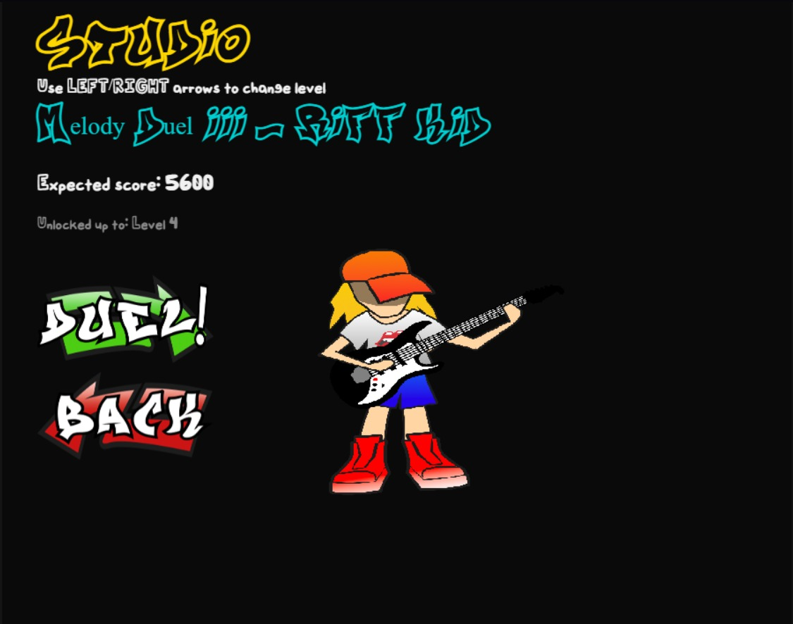
STUDIO

Slide 4
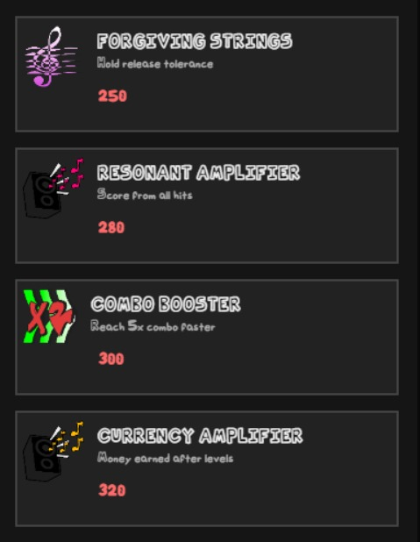
MARKET
Spend earned currency after each duel
Buy permanent upgrades that improve future runs
Shop turns failure into progress (you always gain currency)

Slide 5
CURRENCY AND UPGRADES
At the end of each duel score becomes currency
You earn currency even if you lose, so every attempt progresses you
Spend currency in the shop on permanent upgrades
Upgrade examples: timing tolerance, score multipliers, combo stability, hold note bonuses
Player choice: invest based on your weakness (timing, consistency, risky holds) and shape your playstyle

Slide 6
LONG TERM PROGRESSION
Upgrades stack permanently
New levels unlock, old ones stay replayable
Gradual empowerment: beat levels that felt impossible before

Slide 7
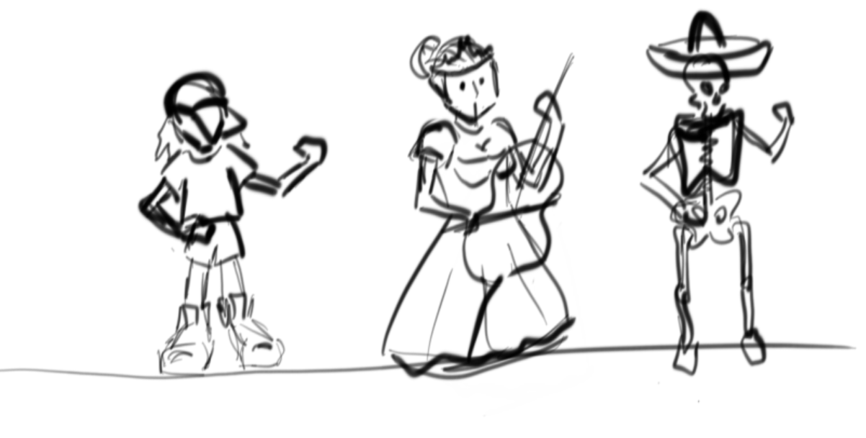
LONG TERM UPDATES
Changing duels format
Adding difficulties to each level
Designing more characters
Using our own beats
More levels!
More upgrades!
Bosses?

Slide 8
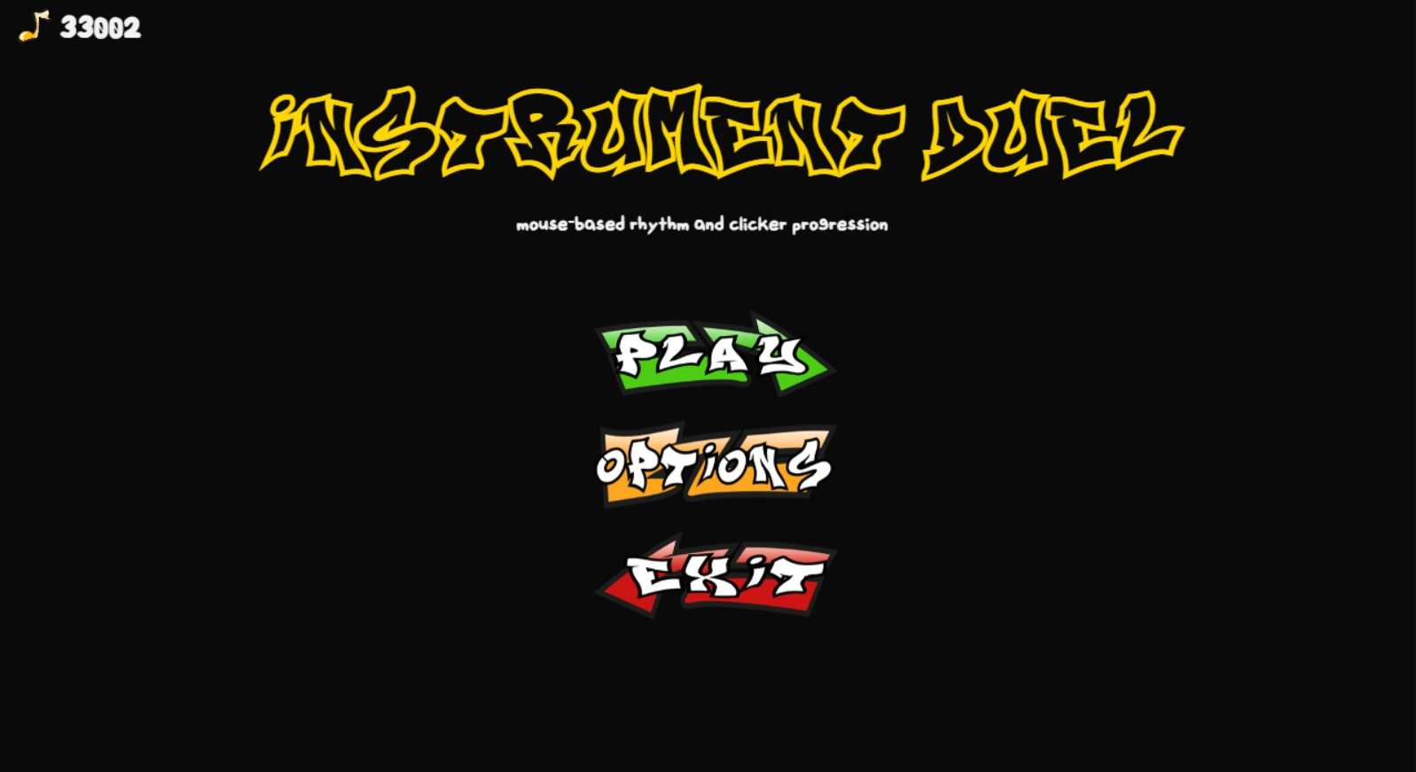
THANKS FOR LISTENING

